Slide 1

Sales performance analysis
Butterfly Sharp Shooters
Gazelle B, Elfie H, John N, Venessa Y

Slide 2

Core Message: Hurley’s 2016 and 2017 sales performance
Identify the most popular categories based on quantity sold – pie chart
Identify the highest margin categories to focus on producing for the upcoming holiday season – bar graph
Sales performance by store locations – bar graph
Whether or not to reduce the promotions in order to drive higher gross margin
The relationship between gross margin rate vs. gross margin dollars
Quantity sold in men’s and women’s over the past 3 years– line graph

Slide 3

Hypotheses
T-shirts and boardshorts are the most popular items
T-shirts and boardshorts have the highest margin
The Bakersfield store have too many promotions that negatively impact gross margin rate
Women’s have higher sales quantity than men’s

Slide 4
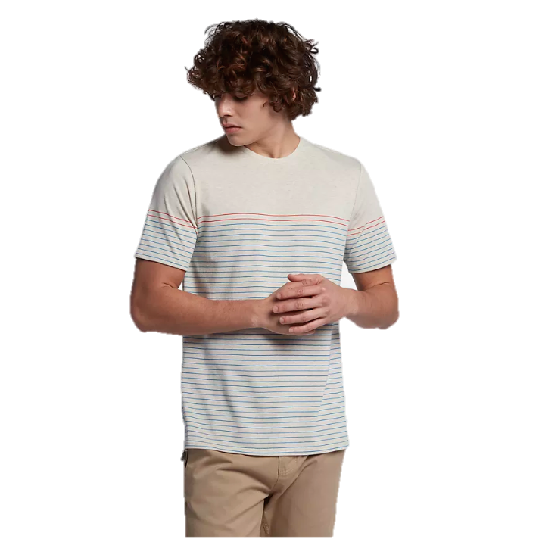
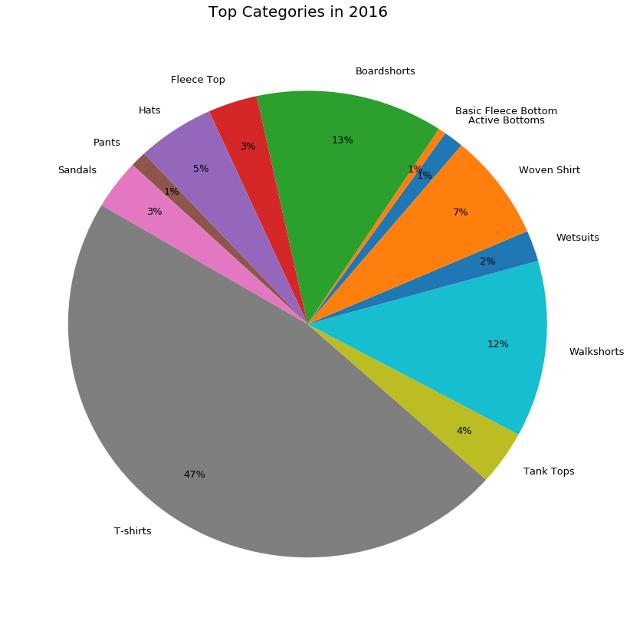
Most Popular Categories in 2016

Slide 5
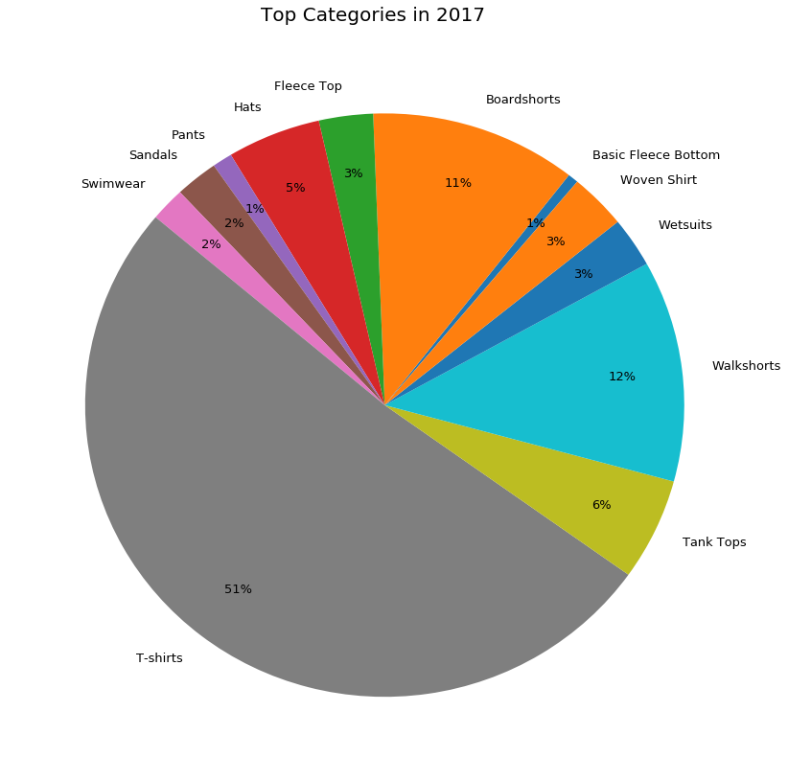
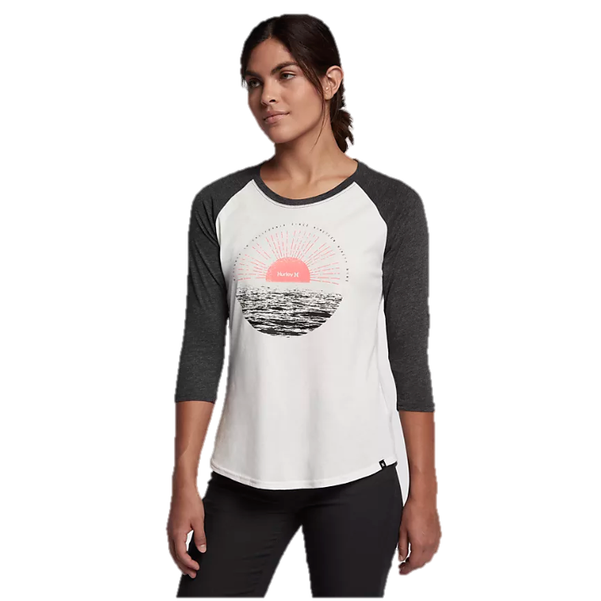
Most Popular Categories in 2017

Slide 6
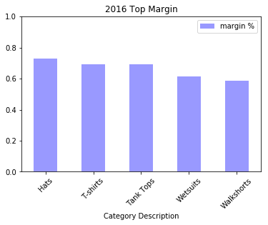
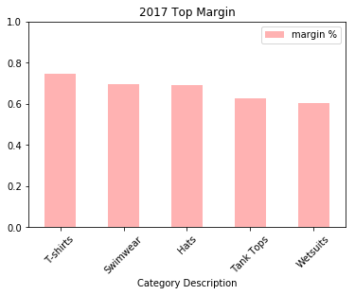
Top Margin Categories

Slide 7
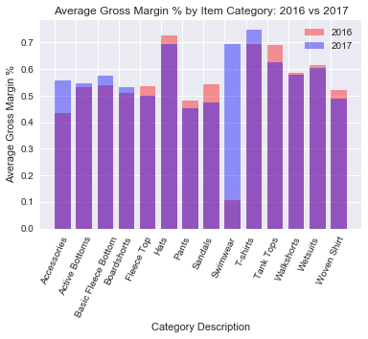
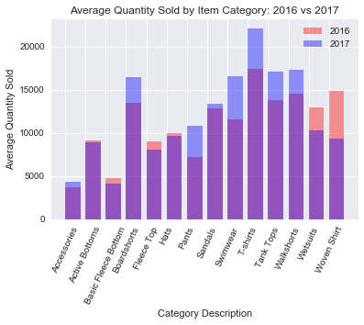
Margins vs Quantity

Slide 8
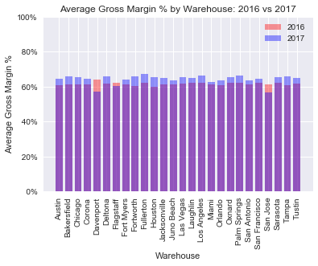
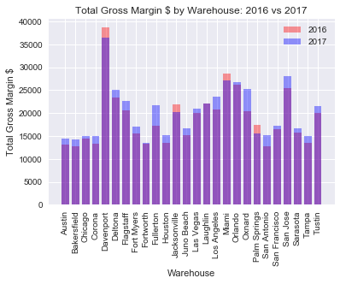
Location vs. Margin
Davenport and San Jose stores have the highest gross margins in dollars
But their gross margin rate has reduced from 2016 to 2017
Notes:
Sales quantity increased across many categories in 2017
Accessories fairly same units sold but gross margin rate grew significantly in 2017
Sandals and tank-tops sold more units but decreased in gross margin rate in 2017

Slide 9
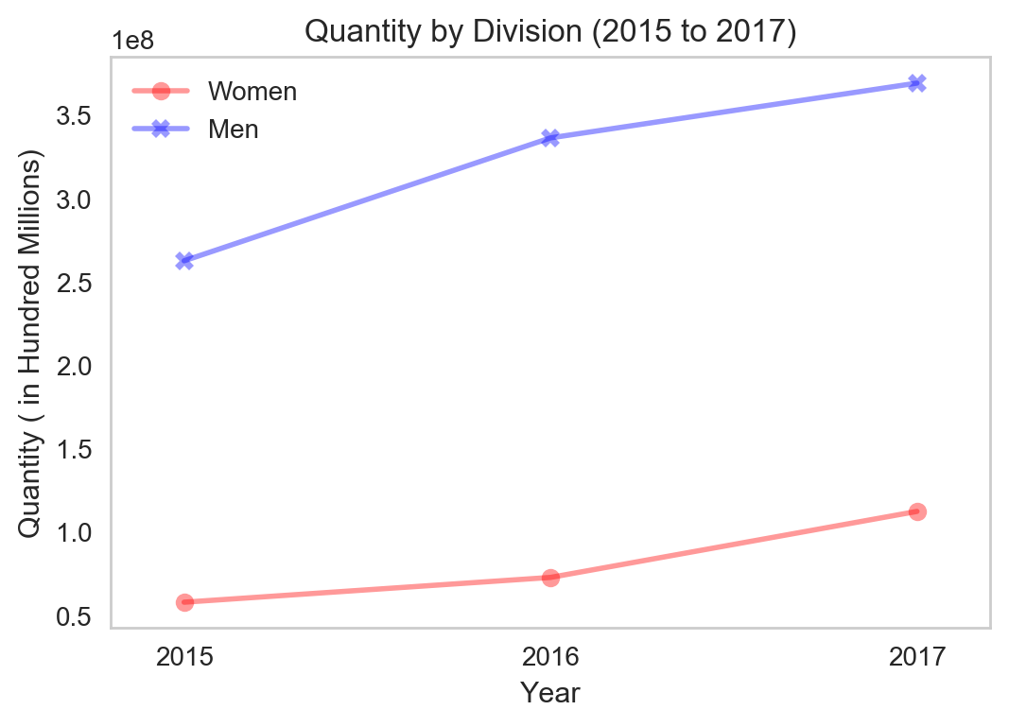

Quantity by Division

Slide 10
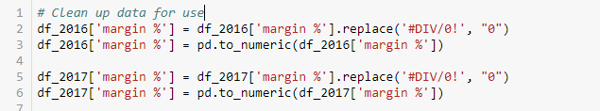
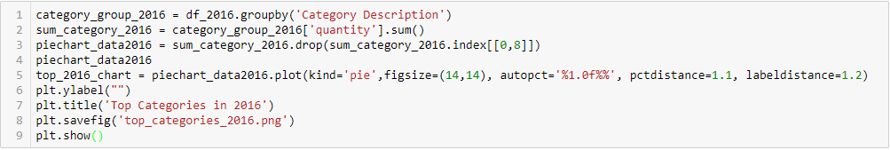
Codes used…
To clean up data:
To sort categories/items by highest quantity sold and plot pie chart:

Slide 11
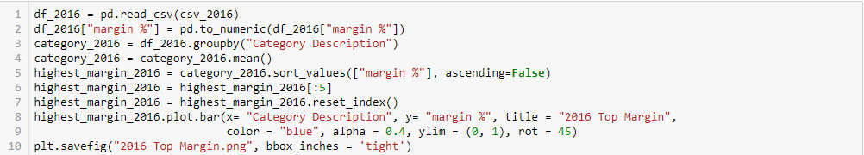
Codes used…
To sort categories/items by highest gross margin rate and plot bar graph:

Slide 12
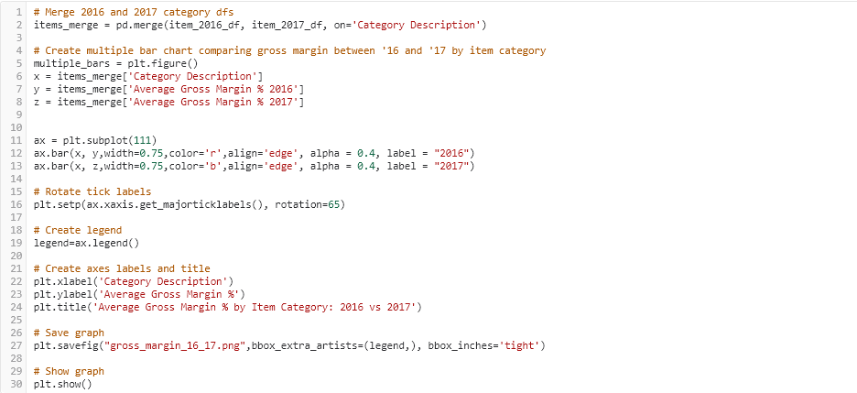
Codes used…
To sort categories/items by gross margin rate for 2016 and 2017, plot bar graph:

Slide 13
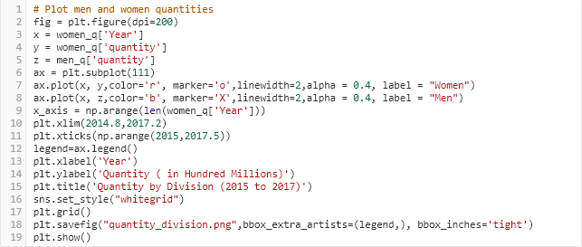
Codes used…
To sort categories/items by gross margin rate for 2016 and 2017, plot line graph:

Slide 14

The End

